Slide 1


David Coyne
The Changing World Of Work
Thursday 9th May 2019

Slide 2
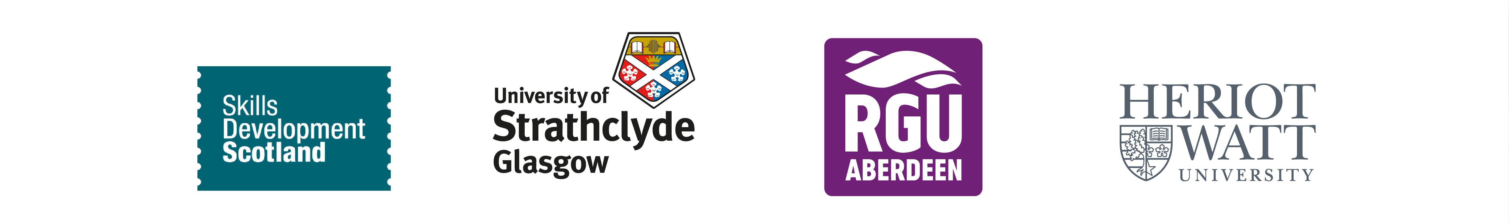
We’re a national body committed to driving cultural change and creating demand for work-based learning in Scotland
Notes:
But first let me introduce CWBL, we set the centre up to:
Support expansion of the apprenticeship family (MAs, to FAs and GAs)
International examples such as Switzerland or Germany (Role of Apprenticeships, vocational education is held in high esteem and employers lead the curriculum)
Some of the research here shows that parents see apprenticeships as an inferior option to further education
Work-based learning as a way of increasing access to education, whilst enabling businesses to have access to people with the right skills
And:
If we believe WBL is one of the keys to a successful economy, to giving young people a good start in the world work and is a route to advanced qualifications, how do we:
improve the perception of apprenticeships
encourage employers to take the lead
advance the science and understanding of the methods of teaching and learning

Slide 3

The Current World of Work
Notes:
In a little over 200 years, we have fundamentally changed the world. Since the start of the Industrial revolution process we have started moving to cities, working in large groups and living lives devoid of our historical connection to nature.
This rapid urbanisation can be very problematic, societies need the social and political systems to manage and mitigate that change. They developed by trial and error in the growth of European cities but urbanisation and city management is now a science, and is one in which opportunities for intelligent systems abound.
So what is Industry 4.0? It is a term first used in Germany to describe a set of changes affecting primarily manufacturing.
These waves of innovation were not and are not discrete events, but broad sets of changes. The key consideration for us is how these changes have affected the human role in the economic process:
1.0 - machines are adding strength and speed
2.0 - by organising into processes efficiency increases
3.0 - the machines can copy the dexterity and accuracy of a human
4.0 - we will move to machine decisions and designs

Slide 4

Innovations in Industry 4.0
The Internet of Things (IoT) and our devices becoming ‘smarter’
Data playing an even bigger role in our lives
AI and machines that can learn
Exponential growth in computing power is fuelling massive tech advances
Notes:
AI and Machines that Can Learn:
Over the past 30 years, the average robot price has fallen by half in real terms, and even further relative to labor costs. As demand from emerging economies encourages the production of robots to shift to lower-cost regions, they are likely to become cheaper still.
In Japan, industrial robots produce industrial robots, supervised by a staff of only four workers per shift.
In a Philips plant producing electric razors in the Netherlands, robots outnumber the nine production workers by more than 14 to 1.
Camera maker Canon began phasing out human labour at several of its factories in 2013.
The Internet of Things:
In the broadest sense, the term IoT encompasses everything connected to the internet, simply, the Internet of Things is made up of devices – from simple sensors to smartphones and wearables – connected together, By combining these connected devices with automated systems, it is possible to "gather information, analyse it and create an action
McKinsey predicts the IoT market will be worth $581B for ICT-based spend alone by 2020
We’re getting used to using our voices to control smart home devices such as Amazon’s Alexa hub, or Apple’s Siri. But 2019 will be the year that the rest of our possessions find their own voice. Virtually every car manufacturer is working on virtual assistants to help drivers more safely and conveniently operate vehicles while behind the wheel.

Slide 5

Notes:
Mobility-as-a-Service (MaaS) describes a shift away from personally-owned modes of transportation and towards mobility solutions that are consumed as a service.
The end of Diesel, the beginnings of autonomous vehicles, car sharing, ride apps and a range of other forces are changing the world of transport. Colleagues in Skills Norway are convinced the last Norwegian ever to need a driving licence has already been born.
What we’ve seen happen at Honda is in part a symptom of that change. A survey of car manufacturing bosses by KPMG found that 74% of executives thought more than half of car owners today would not want to own a vehicle in the future.

Slide 6
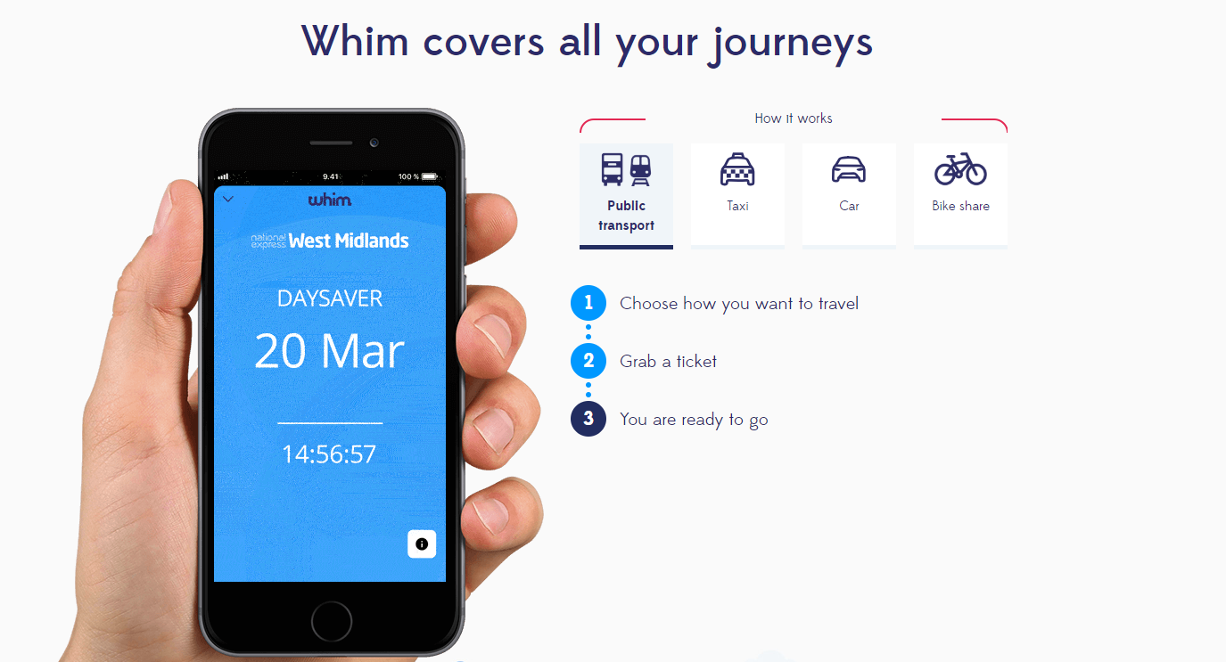
Notes:
Apps such as Whim are revolutionising Urban transport – for a fixed monthly fee users can access bus, taxi and hire cars as and when they need them, paying nothing at the point of use, the implications for not just car manufacturers, but data scientists, programmers and Fintech developers are huge, and that’s before the buses and taxis start driving themselves!

Slide 7

The Future of Work
Notes:
In September 2018, the TUC congress caused some waves when it announced that it was campaigning for a four day week, admittedly not in a short timescale, but there are examples of that kind of thinking actually working. Companies in NZ, Finland and here in Scotland have adopted a four day week and are reporting really positive results.
As it is well known, construction has always had a tradition of self employment, however many days we work, it is unlikely to be in the vast, Cathedral-like corporate structures that dominate the global economy – more and more work will be done by outsourced, and networked individuals. The political debate has begun in the UK on the right to negotiate with companies we contract with as well as those who employ us.
We also now have a planetary labour market, more and more types of work can be outsourced and more and more places can provide the outsourced services.
Inevitably those providing the services will start to exert power. In Bangalore, many drivers have left Uber, and joined a Whats App group which provides a customer interface and a financial cooperative for the drivers.
So if there are no big firms, and highly mobile types of work what does that mean for current ideas of workforce skills development? The individual needs to become the focus of equal attention to the firm and the sector, and we need the tools and the message to engage them.

Slide 8

How to Thrive
Notes:
World Economic Forum looked into the roles of over 15 million workers across 20 different nations and found that AI’s macro-economic impact on the workforce will create more jobs (133 million) than it culls (75 million). The article goes on to quite rightly conclude that automation will transform rather than destroy the jobs market. The question is, how will you thrive in the next chapter of Industry 4.0?

Slide 9
breadth of knowledge
What does
a T-shaped
worker
look like?
depth of expertise
Notes:
A T-shaped employee, in the context of human resources, is an individual who has deep knowledge and skills in a particular area of specialization, along with and the desire and ability to make connections across disciplines. The horizontal bar of the T symbolizes a breadth of general knowledge and soft skills, while the vertical stem of the T symbolizes the depth of technical hard skills. Essentially, a T-shaped individual is both a niche-topic specialist and a generalist with people skills

Slide 10










breadth of knowledge
General tech
understanding
Appreciation of code & development
Visual design insight
Industry knowledge
and skills
Data science competency
Project management
Effective communication to stakeholders
What does the
T-shaped Worker of the future look like?
Entrepreneurial & intrapreneurial skills and drive
Develop deep knowledge/skills in one area
depth of expertise
Actively seek opportunities to develop skills in new areas in & around the core discipline

Slide 11
Self-management
Social Intelligence
Innovation
Taking responsibility for your own
behaviour and well being
Awareness of others’ feelings, needs, and concerns in order to effectively navigate and negotiate complex social relationships and environments
The ability to define and create
significant positive change
Integrity
Feeling
Initiative
Leading
Creativity
Adapting
Focusing
Curiosity
Collaboration
Sense making
Communication
Critical thinking
Notes:
Firstly for individuals:
Ensuring the workforce, be they engineers, marketers, scientists, financial specialists or managers, have the right professional and technical skills so your organisation benefits from everything Industry 4.0 promises to deliver is only part of the workplace challenge.
To ensure we thrive as individuals, we all need to develop new skills. These skills, know as Meta Skills, are not just to help us cope in this environment of ongoing change. They are skills to excel; to collaborate and empathise with others and to create our own futures.

Slide 12

Investing in Employees
Training & Lifelong Learning
Diffused Networks
Notes:
For Businesses:
McKinsey & Co have highlighted the importance of early adoption of technology, employers who are the frontrunners of AI adoption can anticipate 122% cash flow change, while followers of the adoption will only see 10% cash flow change. Therefore companies who move to implementation before waiting for decreased technology and transition costs will realise the greatest benefits due to the competitive advantage.
Investing in Employees: Research from the university of Warwick revealed that happy employees are 12% more productive, therefore employers should deploy technologies that allow employees to focus on the most value-adding activities, where the human skills of decision-making and adaptability to new situations brings most value – and, at the same time, creating a more attractive workplace.
Training & Lifelong Learning: The private and public sector must prepare the workforce for the transition, retool the education system and invest in training as well as lifelong learning to create a mobile workforce that can benefit from the opportunities related to the Industry 4.0. This will not only help workers, but also provide benefits to the companies since a shortage of skills is the most frequent barrier preventing scale-up of technologies.
Geographical Diffusion: The full benefit of the Fourth Industrial Revolution in can only be realised if complete value chains and production systems are transformed, including all geographical areas and SMEs, which are contributing 50–60% of value add in OECD countries. Therefore, companies should diffuse Fourth Industrial Revolution technologies through their entire production network and include developing economies as well as suppliers of all sizes.

Slide 13
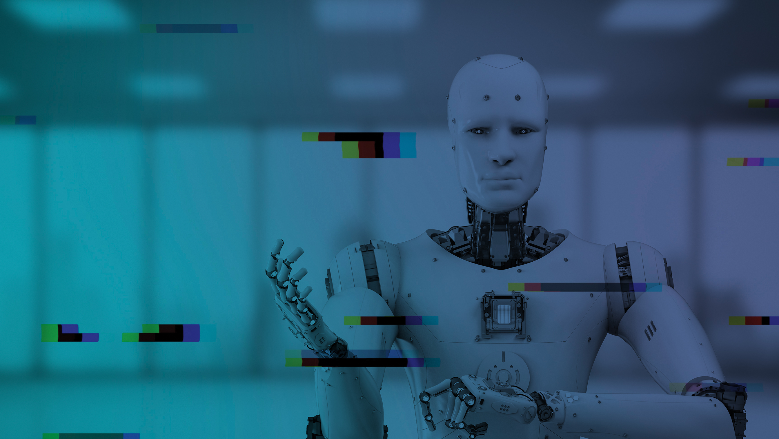
www.centreforworkbasedlearning.co.uk
LinkedIn: Centre for Work-based Learning
Twitter & Instagram: @CWBLScotland
#AHumanFuture

